Slide 1
Creating Cool Figures Using R
By Wyatt Tarter, MS

Slide 2
Visualization Types
Associations
  Scatter plots
  Line plots
  Alluvial plots
  Heat maps
Distributions
  Histograms
  Density plots
  Violin plots
Descriptive
  Bar plots

Slide 3
Basics of R Visualization
Data
  Types
    Matrix
    Data frame - preferable
    Tibble
  Variables
    Categorical
    Continuous
  Formats
    Wide – single row per subject, column for each variable
    Long – multiple rows per subject, condensed columns
Functions
  Input syntax
  Required vs optional
Output

Slide 4
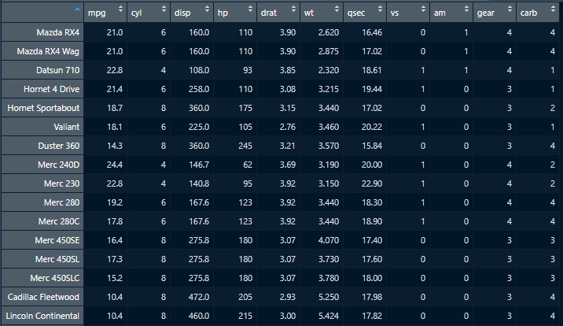
Mtcars Data Set

Slide 5
Base R
plot(x,y,…)
  Ex.
    points()
    lines()
    hist()
  Pro(s):
    Simple to understand and use
  Con(s):
    Harder to augment
    Clunky code
    Default, bland look

Slide 6
GGplot2
ggplot(data, aes(x,y))
  Ex.
    geom_point()
    geom_line()
    geom_hist()
  Pro(s)
    Endlessly flexible
    Generalized format for all graph types
    Easy to create complex figures
    Highly customizable themes
  Con(s)
    Learning curve
    Syntax – google!

Slide 7
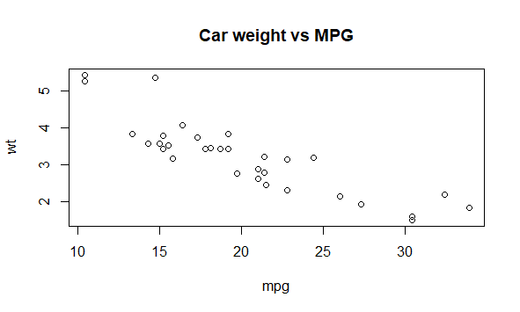
Base R Example
Code in R:
plot(x=mtcars$mpg,
y=mtcars$wt,
ylab="wt",
xlab="mpg",
main="Car weight vs MPG")

Slide 8
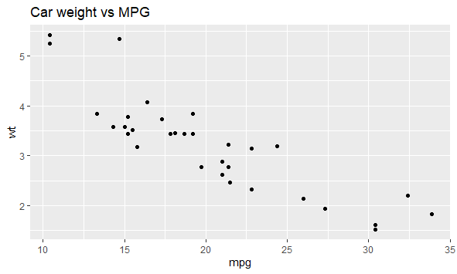
GGPlot Example
Code in R:
ggplot(mtcars, aes(x=mpg, y=wt)+
geom_point()+
labs(title= "Car weight vs MPG")

Slide 9
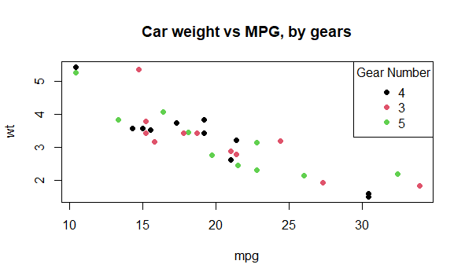
Base R Example
plot(x=mtcars$mpg,
y=mtcars$wt,
ylab="wt",
xlab="mpg",
col=1:length(unique(mtcars$gear)),
main="Car weight vs MPG, by gears",
pch=19)
legend("topright",
legend=unique(mtcars$gear),
col=1:length(unique(mtcars$gear)),
pch=19,
title="Gear Number")

Slide 10
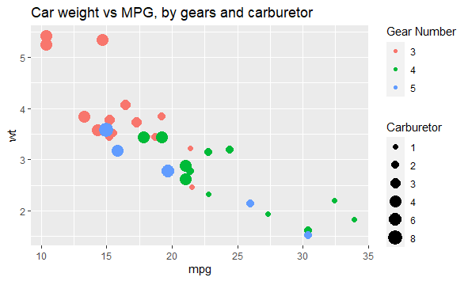
GGPlot Example
ggplot(mtcars,
aes(x=mpg,y=wt,col=factor(gear)),size=factor(carb))+
geom_point(aes(size=factor(carb)))+
labs(title="Car weight vs MPG, by gears and carburetor",
col="Gear Number",
size="Carburetor")

Slide 11
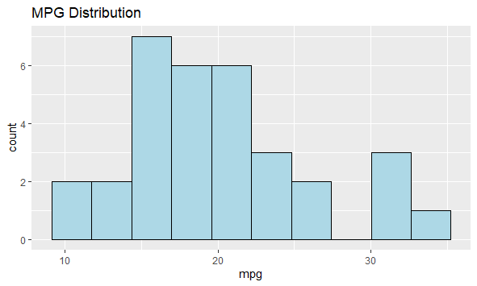
Histograms
ggplot(mtcars,aes(x=mpg))+
geom_histogram(bins=10,
fill="light blue",
col="black")+
labs(title="MPG Distribution")

Slide 12
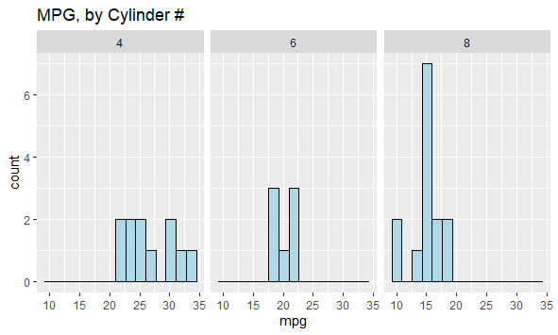
Histograms
ggplot(mtcars,aes(x=mpg))+
geom_histogram(bins = 15,
col="black",
fill="light blue")+
facet_grid(.~cyl)+
labs(title="MPG, by Cylinder #")

Slide 13
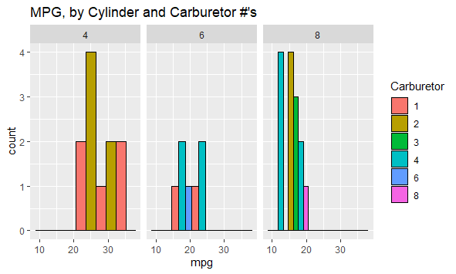
Histograms
ggplot(mtcars,aes(x=mpg,fill=factor(carb)))+
geom_histogram(bins = 5,
col="black",
position = "dodge")+
facet_grid(.~cyl)+
labs(fill="Carburetor",
title="MPG, by Cylinder and Carburetor #'s")

Slide 14
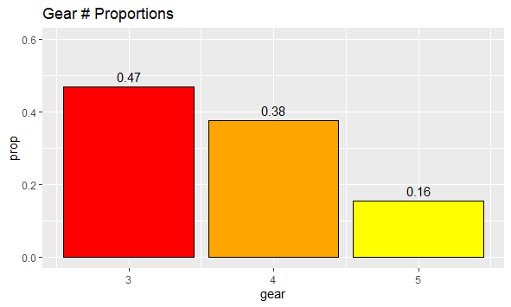
Bar Plot
ggplot(mtcars,aes(x=gear))+
geom_bar(aes(y=..prop..),
fill=c("red","orange","yellow"),
col="black",
stat="count")+
geom_text(aes(label=round(..prop..,2),y=..prop..),
stat="count",
vjust=-0.5)+
scale_y_continuous(limits = c(0,0.6))+
labs(title="Gear # Proportions")

Slide 15
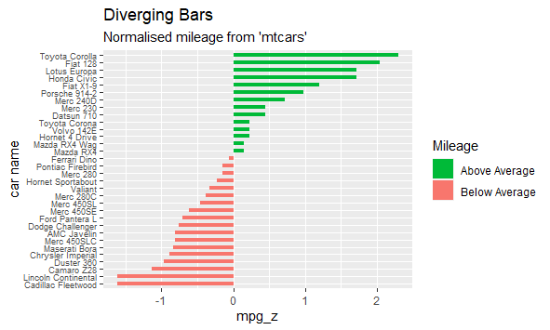
Bar Plot
mtcars%>%
mutate(`car name`=rownames(mtcars),
mpg_z = round(scale(mpg), 2),
mpg_type = ifelse(mpg_z < 0, "below", "above"),
`car name` = factor(`car name`,
levels = mtcars$`car name`))%>%
arrange(mpg_z)%>%
ggplot(., aes(x=`car name`, y=mpg_z, label=mpg_z)) +
geom_bar(stat='identity', aes(fill=mpg_type), width=.5) +
scale_fill_manual(name="Mileage",
labels = c("Above Average", "Below Average"),
values = c("above"="#00ba38", "below"="#f8766d")) +
labs(subtitle="Normalised mileage from 'mtcars'",
title= "Diverging Bars") +
theme(axis.text.y=element_text(size=7))+
coord_flip()

Slide 16
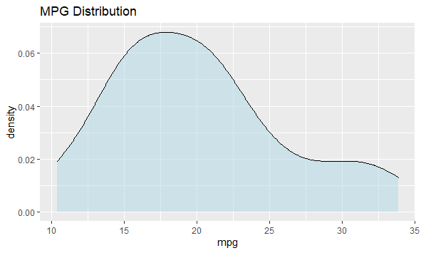
Density Plots
ggplot(mtcars,aes(x=mpg))+
geom_density(fill="light blue",
alpha=0.5)+
labs(title="MPG Distribution")

Slide 17
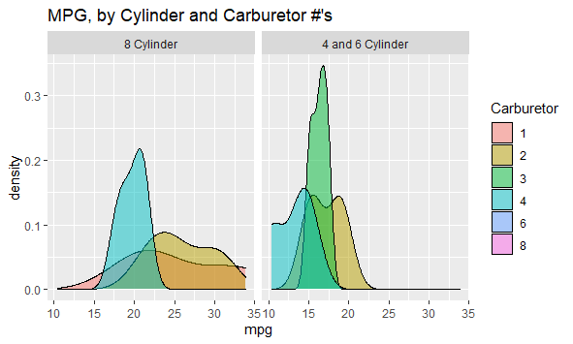
Density Plots
ggplot(mtcars,aes(x=mpg,fill=factor(carb)))+
geom_density(alpha=0.5)+
facet_grid(.~cyl>6,
labeller=as_labeller(c(`TRUE`="4 and 6 Cylinder",
`FALSE`="8 Cylinder")))+
labs(fill="Carburetor",
title = "MPG, by Cylinder and Carburetor #'s")

Slide 18
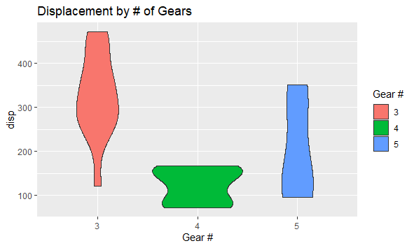
Violin Plot
ggplot(mtcars,
aes(y=disp,x=factor(gear),fill=factor(gear)))+
geom_violin()+
labs(fill="Gear #",
title="Displacement by # of Gears")+
xlab(label="Gear #")

Slide 19
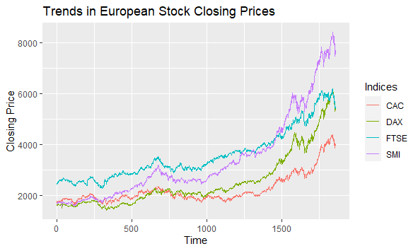
Line Plot
ggplot(EuStockMarketsLong,
aes(x=Time, y=`Closing Price`, col=Indices))+
geom_line()+
labs(title="Trends in European Stock Closing Prices")

Slide 20
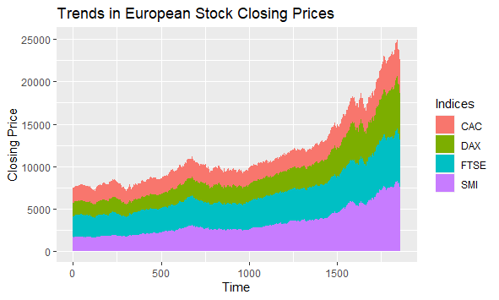
Area Plot
ggplot(EuStockMarketsLong,
aes(x=Time, y=`Closing Price`, fill=Indices))+
geom_area()+
labs(title="Trends in European Stock Closing Prices")

Slide 21
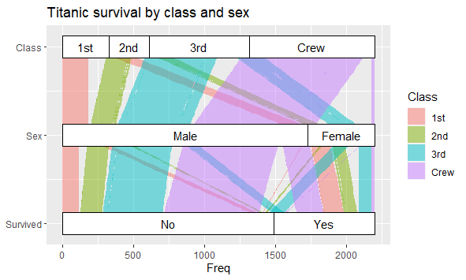
Alluvial Plot (ggalluvial)
ggplot(Titanic,aes(y=Freq,axis1=Survived,axis2=Sex,axis3=Class)) +
geom_alluvium(aes(fill = Class),
width = 0, knot.pos = 0, reverse = FALSE) +
geom_stratum(width = 1/4, reverse = FALSE) +
geom_text(stat = "stratum", aes(label = after_stat(stratum)),
reverse = FALSE) +
scale_x_continuous(breaks = 1:3, labels = c("Survived", "Sex", "Class")) +
coord_flip() +
ggtitle("Titanic survival by class and sex")

Slide 22
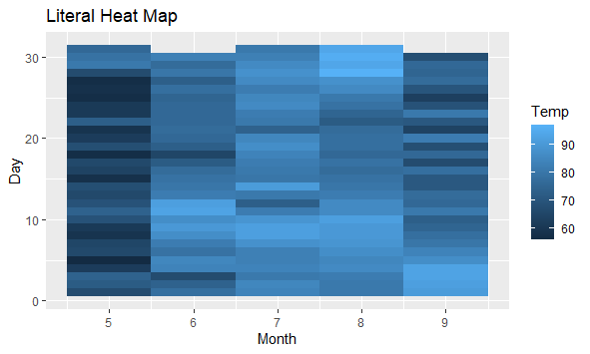
Heat Map
ggplot(airquality,
aes(x=Month,y=Day,fill=Temp))+
geom_tile()+
labs(title="Literal Heat Map")

Slide 23
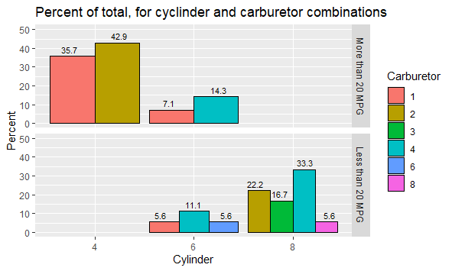
Bar Plots Advanced
ggplot(.,
aes(y=Percent,
x=factor(cyl),
fill=factor(carb)))+
geom_col(position = "dodge",
col="black")+
geom_text(aes(label=round(Percent,1)),
size=3,
vjust=-0.5,
position = position_dodge(width = 1))+
scale_y_continuous(limits = c(0,50))

